Slide 1
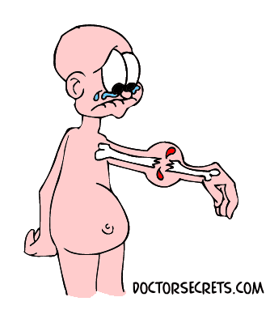
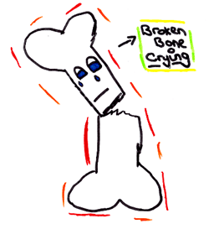
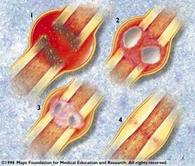

Bone Fracture Healing: Biology and Mechanobiology
Presented By:
Kaushik Mukherjee
Research Fellow
Department of Mechanical Engineering
Indian Institute of Technology Kharagpur
Under the Supervision of:
Dr. Sanjay Gupta

Slide 2
Reasons of Bone Fracture
Traumatic Reasons
Fall
Accidental injuries
Pathological Reasons
Osteoporosis
Metastasis cancer
Prepared by Kaushik Mukherjee

Slide 3
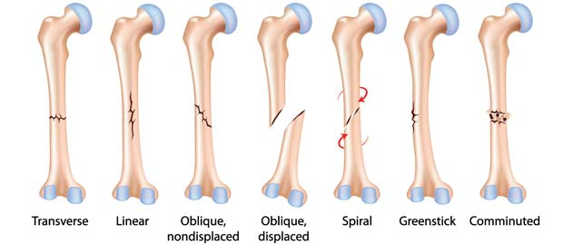
Types of Bone Fracture
Prepared by Kaushik Mukherjee

Slide 4
Biology of Bone Fracture Healing
Prepared by Kaushik Mukherjee

Slide 5
Fracture Healing Sequences
Inflammation
Soft Callus Formation
Hard Callus Formation
Remodeling of Bone
Prepared by Kaushik Mukherjee

Slide 6
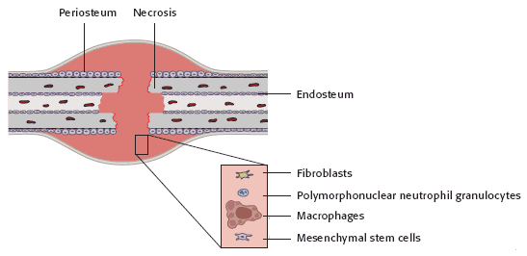
Inflammation (bone fracture - five days)
Prepared by Kaushik Mukherjee

Slide 7
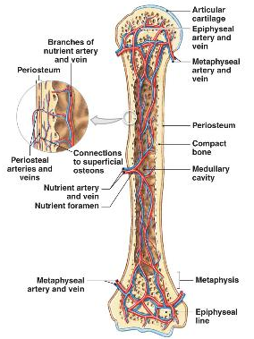
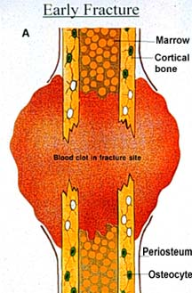
Inflammation (bone fracture - five days)
Haematoma Formation
Prepared by Kaushik Mukherjee

Slide 8
Inflammation (bone fracture - five days)
Bone has a very good blood supply due to the channels within its structure.
A fracture massively disrupts this channel and causes a large amount of bleeding from the fracture segments.
This causes immediate swelling of the fractured region.
These extravascular blood cells clot and forms haematoma .
The damaged bone tissue and the cells within the blood clot start degenerating leading to death.
Near the injured area the fibroblasts survive and replicate to form a loose aggregate of cells, interspersed with small blood vessels, known as granulation tissue.
The Granulation tissue forms a 'scaffold' between the two fragments, from which the formation of a Soft Callus can begin.
Prepared by Kaushik Mukherjee

Slide 9
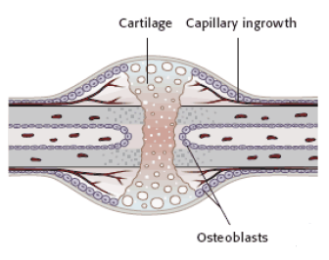
Soft Callus Formation (four days – three weeks)
Fibroblast cells and Mesenchymal stem cells (MSCs) present in the Granulation tissue begin to form Cartilage and Fibrocartilage.
This is a spongy material that fills the gap between the two fracture fragments.
The callus remains quite weak to external stresses however the callus provides sufficient stability at the fracture site for new blood vessels to begin forming.
Prepared by Kaushik Mukherjee

Slide 10
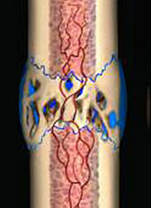
Hard Callus Formation (Two weeks – six or twelve weeks)
Complete conversion of callus into calcified tissue through ossification.
The MSCs proximal (closest) to the fracture gap develop into chondrocytes which form hyaline cartilage.
The MSCs distal to (further from) the fracture gap develop into osteoblasts which form woven bone.
The fibroblasts within the granulation tissue develop into chondrocytes which also form hyaline cartilage.
Prepared by Kaushik Mukherjee

Slide 11
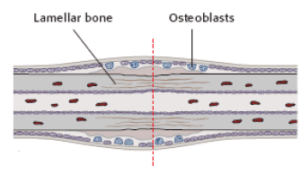
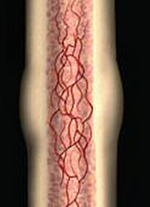
Remodeling of Bone (Three – Five years)
Loosely organised woven bone slowly transform into highly organised lamellar bone, through the process of bony substitution.
Hyaline cartilage is being transformed into lamellar bone, through the process of endochondral ossification.
At the end of the fracture healing process, the bone should closely represent its original shape and strength.
Prepared by Kaushik Mukherjee

Slide 12
Treatments of Bone Fracture
Surgical
Use of metal rods or plates to hold the bone pieces together.
Conservative
Use of pain relieving medicines.
Use of brace or splints or plaster cast to provide support and immobilize the bones
Mechanical Environment regulates the Fracture Healing Process!!!
Important Note: Immobilization of joints is required for proper fracture healing. Why??
Movement of fracture fragments prevents osteoblast activity and formation of new bone
Prepared by Kaushik Mukherjee

Slide 13
Mechanobiology of Bone Fracture Healing
Prepared by Kaushik Mukherjee

Slide 14
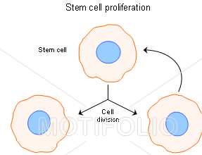
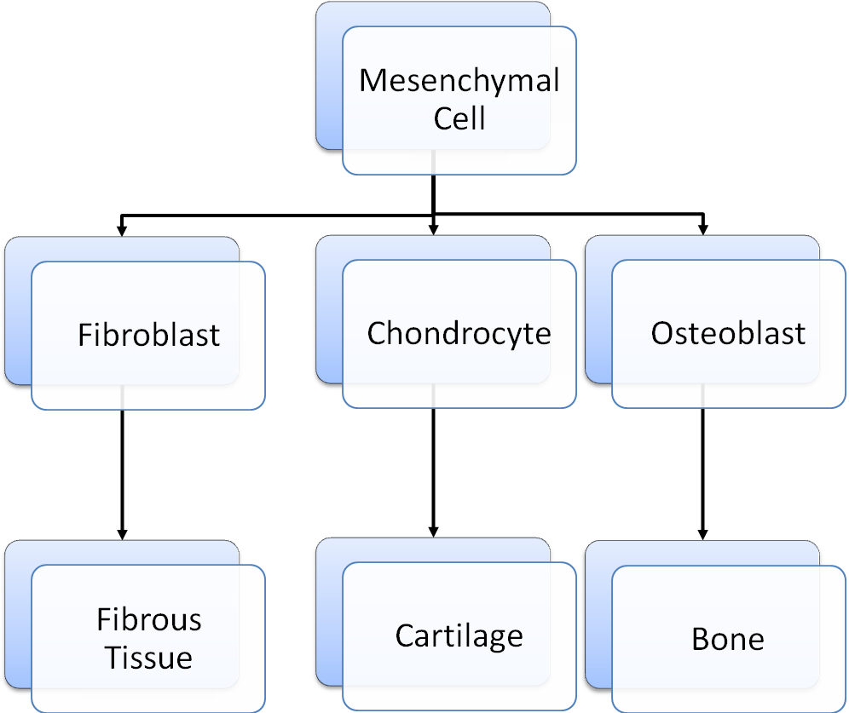
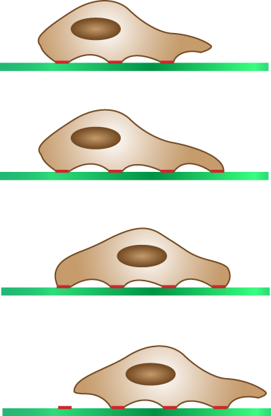
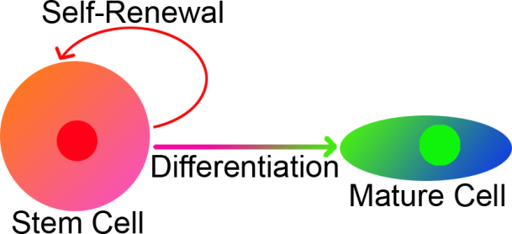
Bone Fracture Healing: Biological Events
Biological Events:
Tissue Formation through Generation of Extra-cellular Matrix
Biological Events:
Cell Migration
Cell Proliferation
Cell Differentiation
Prepared by Kaushik Mukherjee

Slide 15
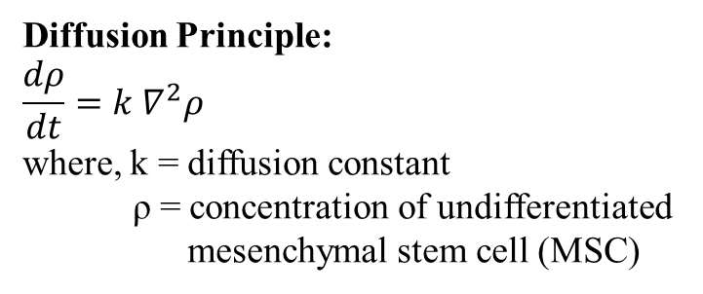
Mathematical Modelling: Phenomenological model (Lacroix and Prendergast 2002)
Cell Proliferation Cell Migration
Cell differentiation
Mechanoregulatory Tissue Algorithm
Extracellular Matrix generation and tissue formation is not modelled.
Prepared by Kaushik Mukherjee

Slide 16
Mathematical Modelling: Cellular model (Andreykiv et al. 2008, Isaksson et al. 2008)
Mesenchymal Cell
Fibroblast Cell
Chondrocyte Cell
Osteoblast Cell
All the coefficients depend on Mechanoregulatory principle!!!
Prepared by Kaushik Mukherjee

Slide 17
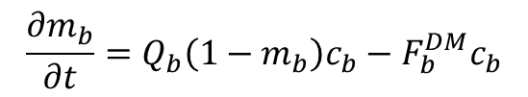
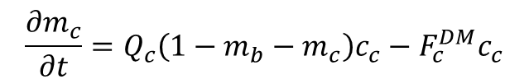
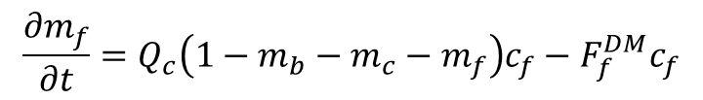
Mathematical Modelling: Cellular model (Andreykiv et al. 2008, Isaksson et al. 2008)
Bone Tissue
Cartilage Tissue
Fibrous Tissue
All the coefficients depend on Mechanoregulatory principle!!!
Prepared by Kaushik Mukherjee

Slide 18
Mechanoregulatory Principle: Material Modelling of Tissue
Tissue
Single Phase Material Representation Stress Invariants Octahedral Stress Hydrostatic Stress
Answers: Change of cell shape Flattening of tissue
Two-Phase Porous Material Representation Interstitial Fluid Velocity Permeability of Tissue
Porosity of Tissue Answers: How the stresses are being carried out by different constituents of a tissue
Prepared by Kaushik Mukherjee

Slide 19
Mechanoregulatory Principle Single Phase Material Representation of Tissue Claes et al. (1999)
Predicted Tissue Type | Principal Strain (%) | Hydrostatic Pore Pressure (MPa)
Fibrous Tissue | - >5 <-5 | >0.15 >-0.15 >-0.15
Cartilage | >15 <-15 | <-0.15
Immature Bone | -15 to 15 | ≤-0.15
Mature Bone | - 5 to 5 | -0.15 to 0.15
Prepared by Kaushik Mukherjee

Slide 20
Mechanoregulatory Principle Two-Phase Porous Material Representation of Tissue Lacroix and Prendergast (2002)
Predicted Tissue Type | Deviatoric Strain (%) SS & Fluid Flow (μm/s) FF
Fibrous Tissue | i>3
Cartilage | i>1
Immature Bone | i>0.267
Mature Bone | i>0.010
Resorption | i≤0.010
i= SS/3.75 + FF/3
Prepared by Kaushik Mukherjee

Slide 21
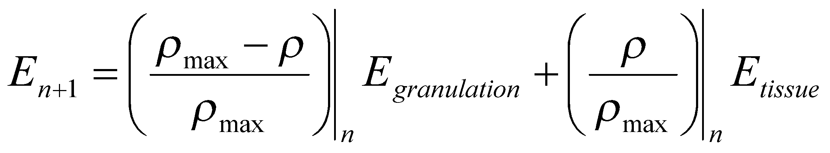
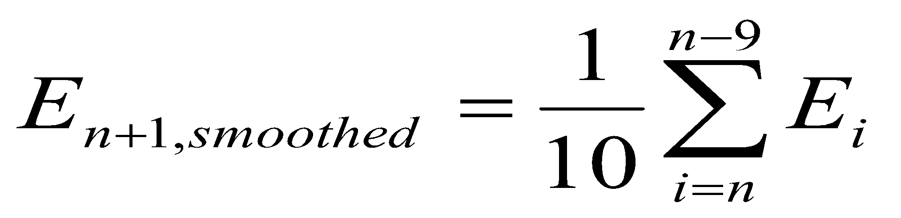
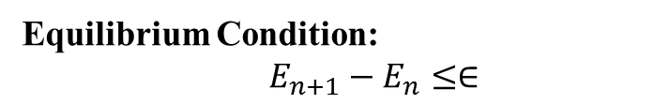
Mechanobiology of Bone Fracture Healing
Iterative Update of Material Properties (Lacroix and Prendergast 2002):
Homogenisation Principle (Lacroix and Prendergast 2000):
Prepared by Kaushik Mukherjee

Slide 22
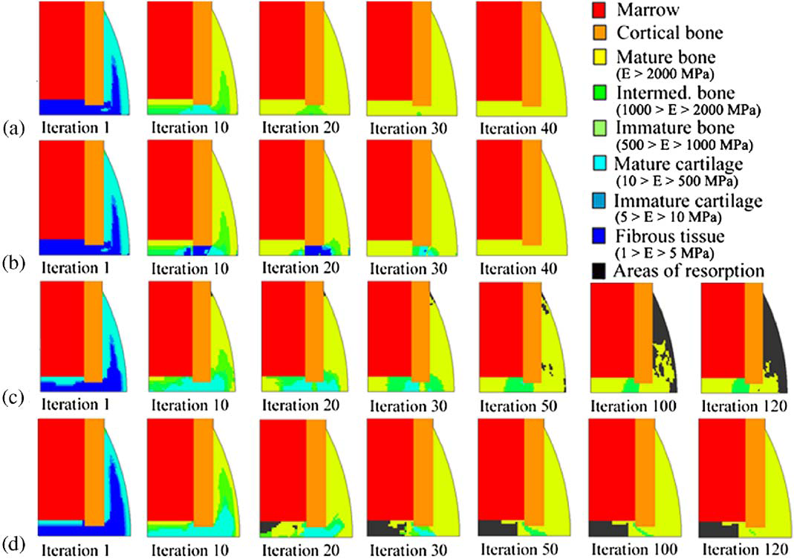
Comparison: Single Phase Material vs Two Phase Material
Single Phase Material with Phenomenological Model
Two Phase Porous Material with Phenomenological Model
Prepared by Kaushik Mukherjee

Slide 23
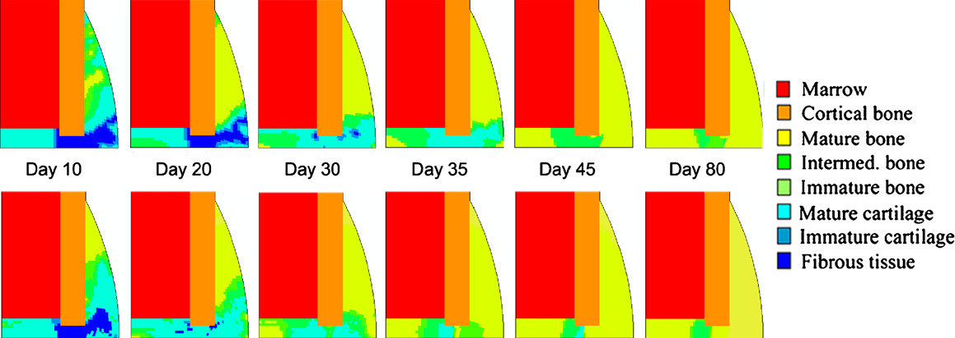
Comparison: Phenomenological Model vs Cell-specific Model
Phenomenological Model with Two Phase Porous Material
Cell-specific Model with Two Phase Porous Material
Prepared by Kaushik Mukherjee

Slide 24
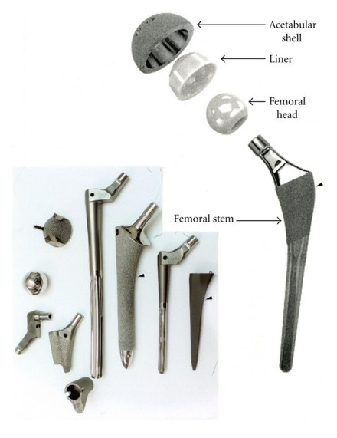
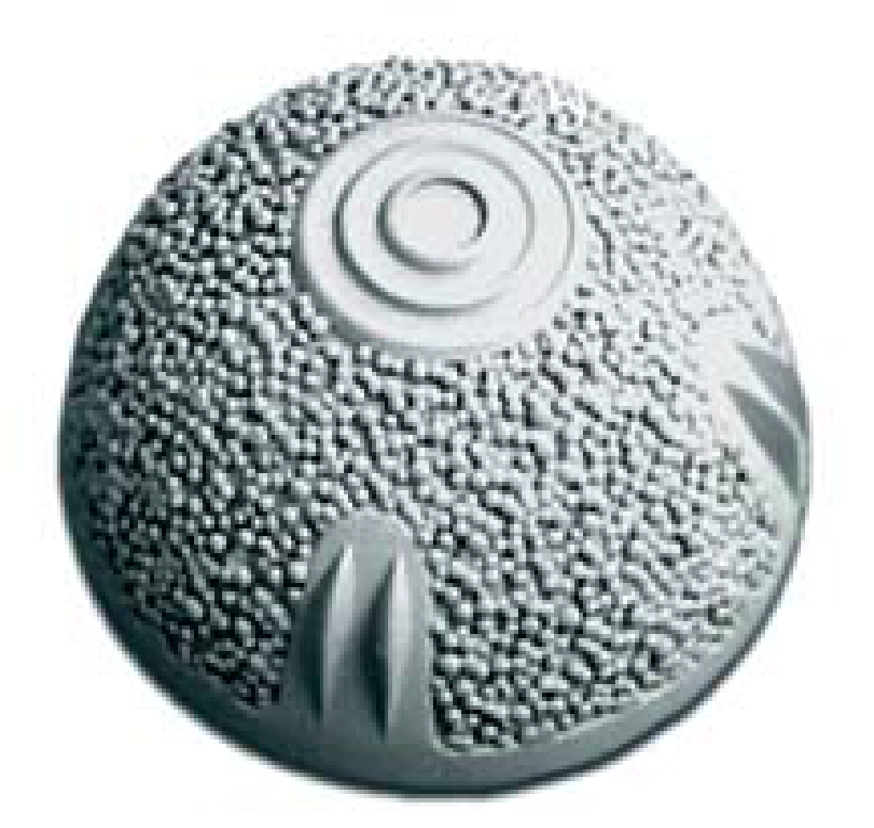
Application of Mechanoregulatory Fracture Healing Algorithm
Periprosthetic Bone Ingrowth
BHR acetabular cup
Prepared by Kaushik Mukherjee

Slide 25
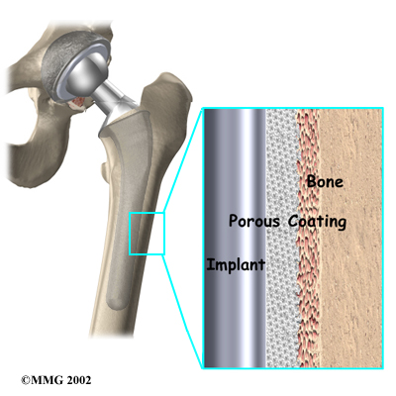
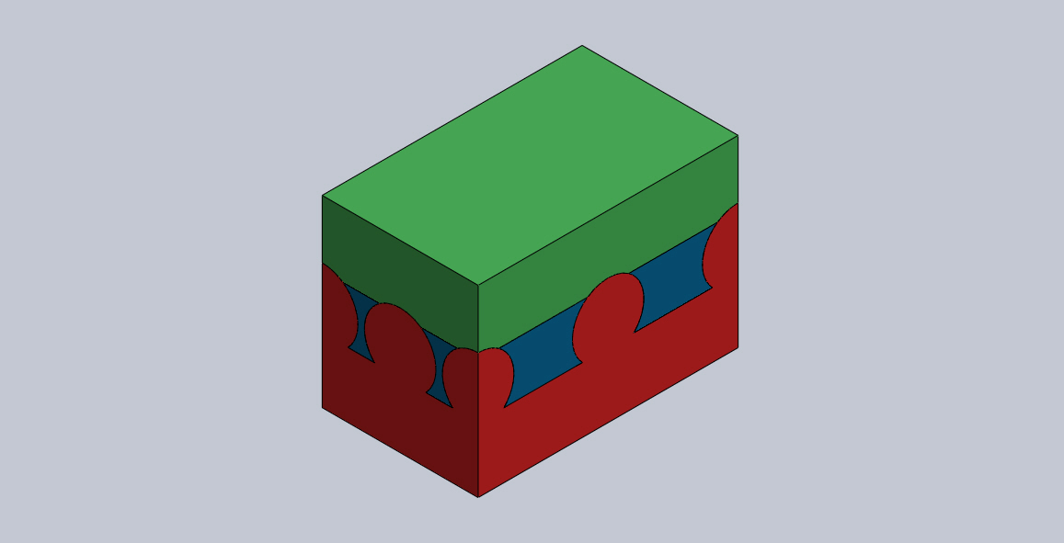
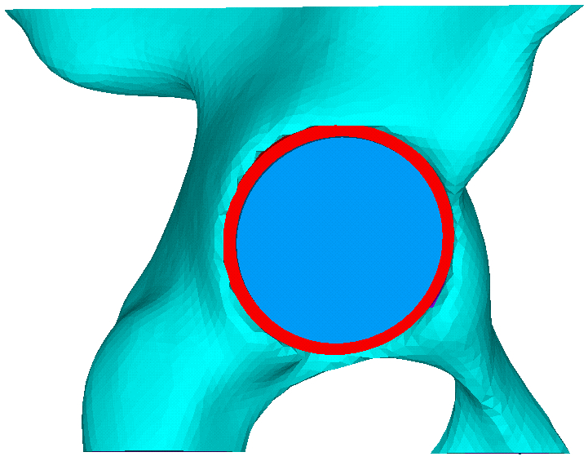
Application of Mechanoregulatory Fracture Healing Algorithm
Periprosthetic Bone Ingrowth
Macroscopic model: implanted femoral
Implant-tissue-bone interface: microscale model
Macroscopic model: implanted pelvis
Prepared by Kaushik Mukherjee

Slide 26
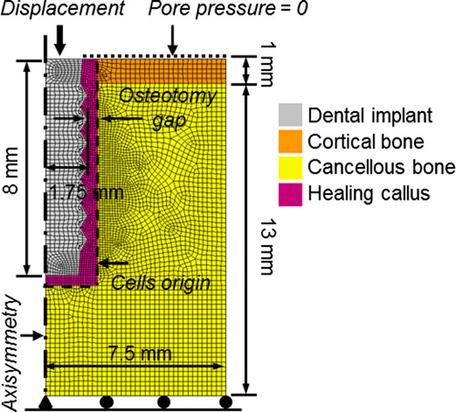
Application of Mechanoregulatory Fracture Healing Algorithm
Periprosthetic Bone Ingrowth
Prepared by Kaushik Mukherjee

Slide 27
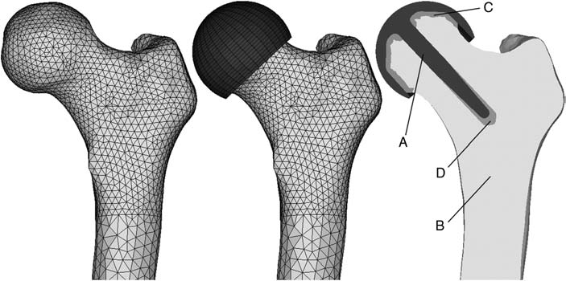
Application of Mechanoregulatory Fracture Healing Algorithm
Bone growth in the Implant-bone Gap
The FE mesh in the intact (left) and implanted femur (centre), and a cross section of the implant (A), bone (B), cement (C) and stem bore defect (D) geometry (right).
Prepared by Kaushik Mukherjee

Slide 28
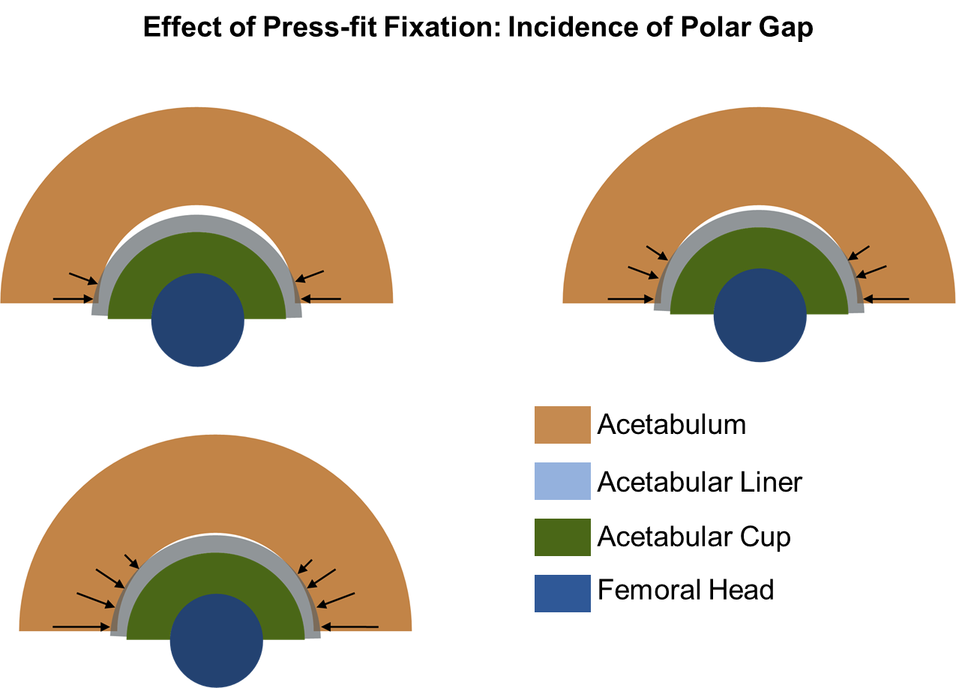
Application of Mechanoregulatory Fracture Healing Algorithm
Bone growth in the Implant-bone Gap
Prepared by Kaushik Mukherjee

Slide 29

Prepared by Kaushik Mukherjee

